Slide 1
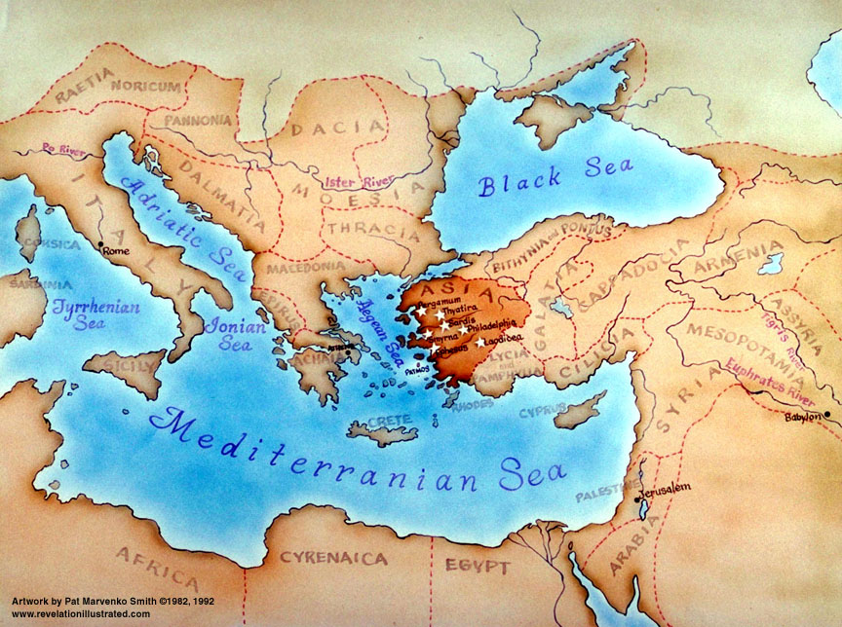
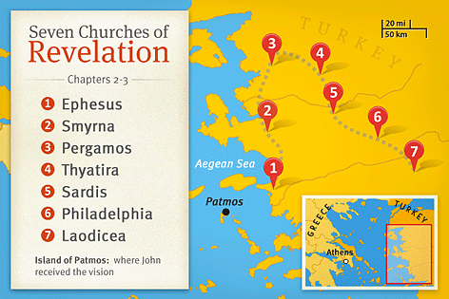

Slide 2
Revelation 3:7-13

Slide 3
⁷ “And to the angel of the church in Philadelphia write: ‘The words of the holy one, the true one, who has the key of David, who opens and no one will shut, who shuts and no one opens.
⁸ “ ‘I know your works. Behold, I have set before you an open door, which no one is able to shut. I know that you have but little power, and yet you have kept my word and have not denied my name. ⁹ Behold, I will make those of the synagogue of Satan who say that they are Jews and are not, but lie — behold, I will make them come and bow down before your feet, and they will learn that I have loved you. ¹⁰ Because you have kept my word about patient endurance, I will keep you from the hour of trial that is coming on the whole world, to try those who dwell on the earth.

Slide 4
¹¹ I am coming soon. Hold fast what you have, so that no one may seize your crown. ¹² The one who conquers, I will make him a pillar in the temple of my God. Never shall he go out of it, and I will write on him the name of my God, and the name of the city of my God, the new Jerusalem, which comes down from my God out of heaven, and my own new name. ¹³ He who has an ear, let him hear what the Spirit says to the churches.’

Slide 6
The policy of the Jewish Synagogue: ^{John 9:22....} if anyone should confess Jesus to be Christ, he was to be put out of the synagogue.
Excluded for confessing Jesus to be The Christ!!!
Any person or religion that doesn’t accept that Jesus is the Christ, are not children of God, but of the devil
The synagogue claimed to be the ‘connect’ between their forefathers and the future messiah. But they rejected Jesus the Messiah
Jesus opens the door to glory to those who do confess His Name
Jesus didn’t have anything bad to say about this church.
I know you have but little power
Commended for patient endurance
No matter how much rejection / suffering
Commended for not denying Jesus’ Name
They openly shared the Gospel in the community around them, no matter how much they were shut out because of it
Will we only proclaim Christ from a position of strength / influence / when the world looks up to us? Or will we proclaim Christ from our weakness?

Slide 7
The policy of the Jewish Synagogue: ^{John 9:22....} if anyone should confess Jesus to be Christ, he was to be put out of the synagogue.
Jesus didn’t have anything bad to say about this church.
I know you have but little power
Commended for patient endurance
No matter how much rejection / suffering
Commended for not denying Jesus’ Name
They openly shared the Gospel in the community around them, no matter how much they were shut out because of it
Will we only proclaim Christ from a position of strength / influence / when the world looks up to us? Or will we proclaim Christ from our weakness?
To follow the path that opens the doors of heaven, will very often mean, that the doors of the world will slam in our face
A pillar in the temple of God – Permanently joined to God in His Glory
A healthy church is full of pillars – full of people who always witness for Christ; patiently endure; trust in Jesus

